Slide 1


Omicron
& Public Health
COVID Variants
Coping With COVID
Mask Etiquette
Free COVID Home Testing
Handwashing
HPU Nursing Class of 2023

Slide 2
Get to Know Omicron and Delta Variants
Name | Omicron B.1.1.529 | Delta B.1.617.2
First Identified | South Africa | India
Spread | Spreads easier than other variants | Spreads easier than other variants
Symptoms | Fever, chills, shortness of breath, difficulty breathing, fatigue, muscle or body aches, headache, new loss of taste or smell, sore throat, congestion or runny nose, nausea or vomiting, diarrhea
Severe illness and Death | Data suggest it is less severe in general however a surge can lead to more hospitalizations | May cause more severe cases than other variants
Vaccine | Breakthrough infections in people who are vaccinated are expected however vaccines prevent illness, hospitalizations, and death. | Early evidence shows that people with vaccine that are infected can spread virus to others. FDA approved vaccines prevent illness, hospitalizations, and death
Treatment | Some, but not all, monoclonal antibody treatments remain effective against Omicron. | All FDA approved monoclonal antibody treatments are effective against Delta
Back
https://www.cdc.gov/coronavirus/2019-ncov/variants/about-variants.html?CDC_AA_refVal=https%3A%2F%2Fwww.cdc.gov%2Fcoronavirus%2F2019-ncov%2Fvariants%2Fvariant.html

Slide 3
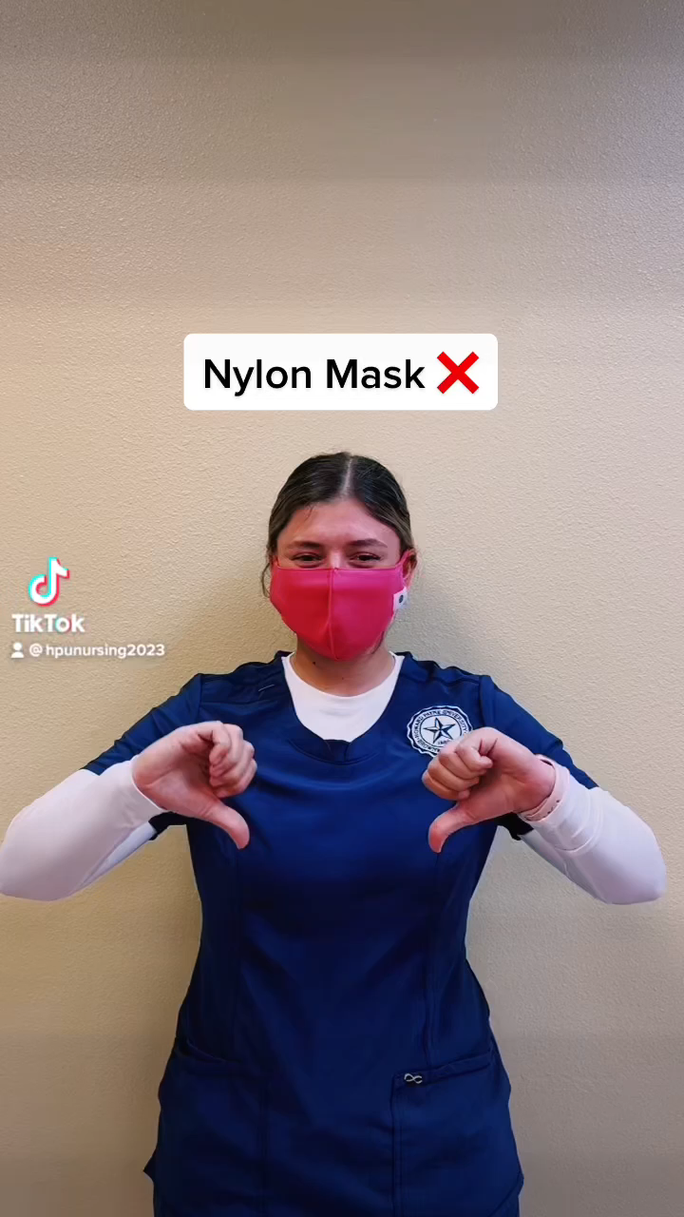
Do’s vs. Don’ts Mask Etiquette
Types of masks:
Surgical masks and respirators offer a higher level of protection.
Gators and single-layered cloth masks can spread infection because it makes the particles finer.
Click on the link for more information from the Centers Disease Control (CDC)!
https://www.cdc.gov/coronavirus/2019-ncov/prevent-getting-sick/cloth-face-cover-guidance.html
Back

Slide 4
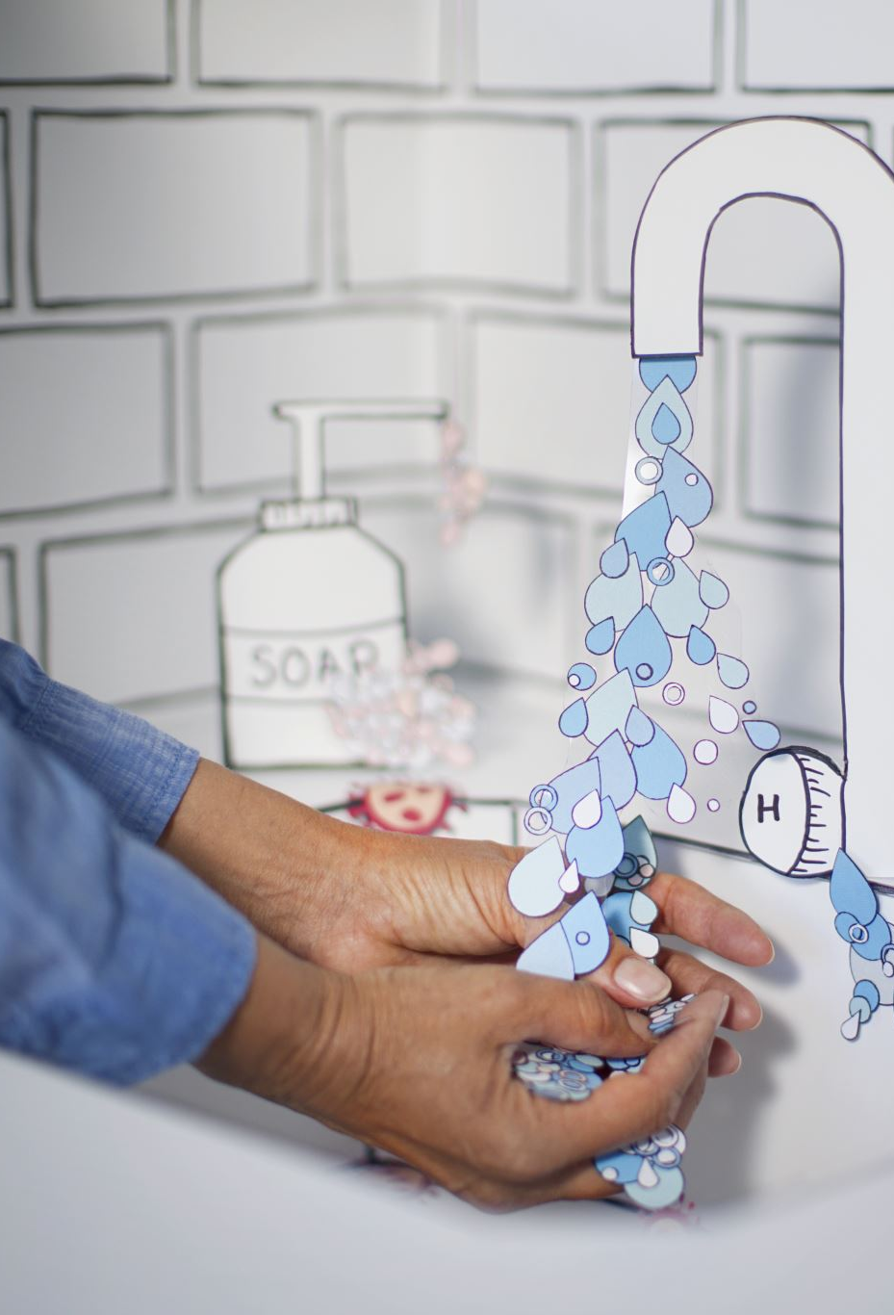
Clean Hands Save Lives
Helps Prevent Infections:
People often touch their eyes, nose, and mouth without realizing it, introducing new germs to their bodies
Germs from unwashed hands may get into foods and drinks when people prepare or consume them. Germs can grow in some types of foods and drinks.
Germs from unwashed hands can be transferred to other objects such as doorknobs, tables, or toys and transferred to another persons.
Hand washing can prevent 1 in 3 diarrhea related sicknesses and 1 in 5 respiratory infections, like COVID and flu.
Watch this 1-minute video over how dirty common surfaces really are!
https://newsnetwork.mayoclinic.org/discussion/mayo-clinic-minute-how-dirty-are-common-surfaces/
Back

Slide 5
Coping with COVID
It’s okay to not be okay
Ways to cope with stress:
Take breaks from watching, reading, or listening to news stories. It’s good to be informed but hearing about the pandemic can be upsetting. Consider limiting news to a couple times a day.
Take care of your body:
Take deep breaths, stretch, or meditate
Try to eat healthy, well-balanced meals
Exercise regularly and make time to unwind
Get plenty of sleep and think of your happy place
Avoid excessive alcohol, tobacco, substance use, and stress
Continue with routine preventative measures (vaccinations, screenings, etc.) as recommended by health care provider
Connect with others, your community, or faith-based organizations via online, social media and phone/email
https://www.cdc.gov/mentalhealth/stress-coping/cope-with-stress/index.html
https://www.texasnurses.org/mpage/TPAPN
Back

Slide 6
Free COVID Home Testing
Can be taken anywhere
Gives results within 30 minutes (no lab drop-off required)
Works whether or not you have COVID-⁠19 symptoms
Works whether or not you are up to date on your COVID-⁠19 vaccines
Referred to as self-tests or over-the-counter (OTC) tests
Click the link to order free home tests! https://www.covidtests.gov/
Rapid antigen at-home tests, not PCR (PCR’s take longer than rapid tests.)
Back

Slide 7
Thank you for your time!
Bree Cason, Veaney Cazares, Madison Gilder, Sydney Horton, Delilah Munoz, Josh Williams, and Howard Payne Nursing Administration
Back

