Slide 1


Slide 2
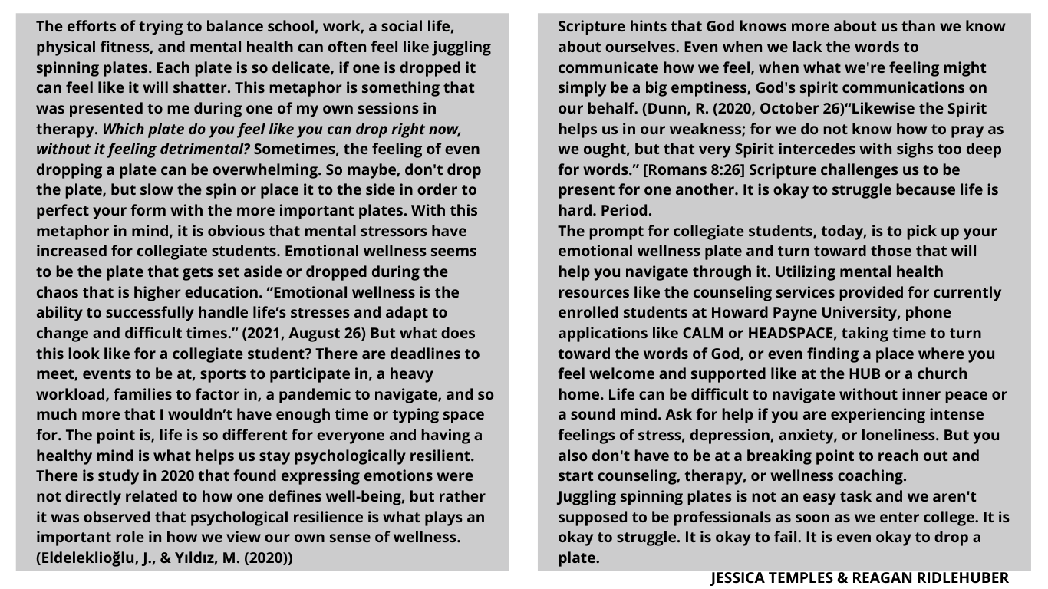

Slide 3
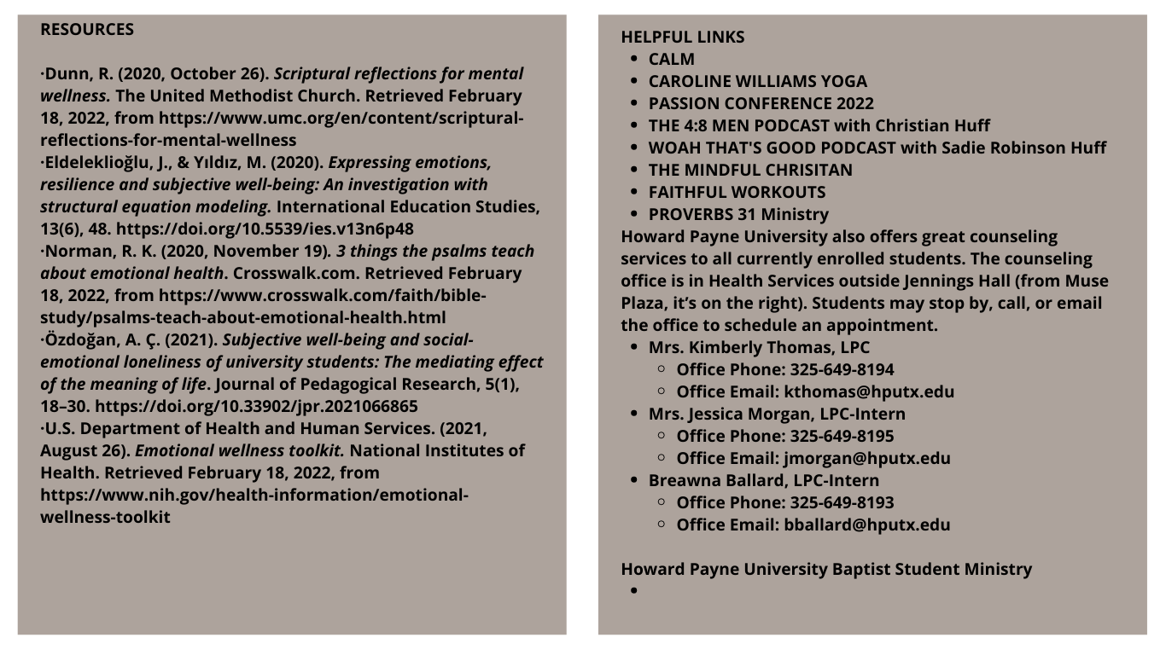
https://www.calm.com/
https://www.youtube.com/channel/UC0n6WQ3_PAePXz_IZzXZFGA
https://www.passiondigitalallaccess.com/passion-2022
https://www.themindfulchristian.com/
https://faithfulworkouts.com/
https://proverbs31.org/
https://www.hputx.edu/student-experience/student-resources/
https://www.hputx.edu/student-experience/baptist-student-ministry/

